Slide 1
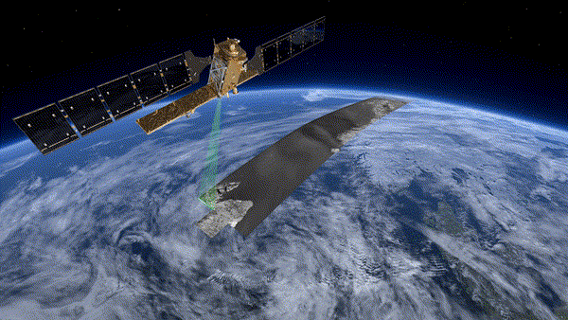
2019: A SPACE FORESTRY
Notes:
Hi everyone! Thank you for coming to see us today.

Slide 2



THE TEAM
Munib Mešinović
Electrical Engineering
Forever Game of Thrones
Mahrukh Tauseef
Electrical Engineering
Big Fan of Dogs
Ken Iiyoshi
Computer Engineering
Japanese Comedy Aficionado

Slide 3
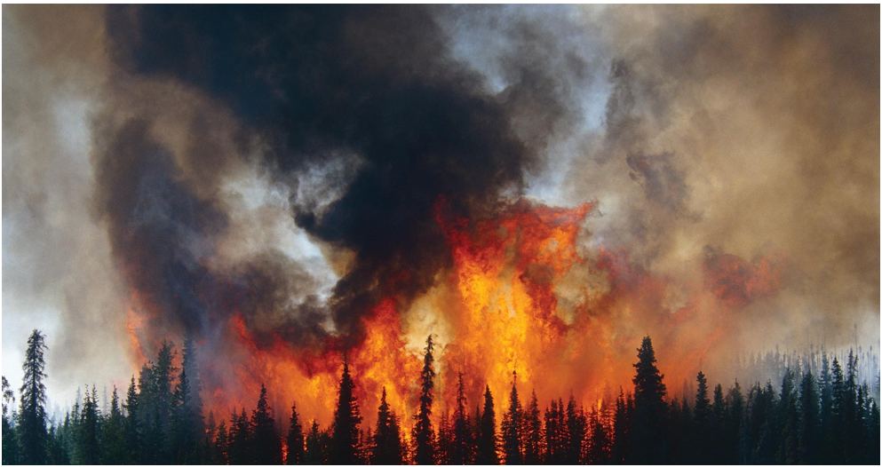
MOTIVATION
“Climate changes directly and indirectly affect the growth and productivity of forests through changes in temperature, rainfall, weather, and other factors.” US EPA
Changing forest ecosystems tell us about:
CO2 emissions in the region
Drought
Temperature
Erosion
Pests
Notes:
Munib

Slide 4
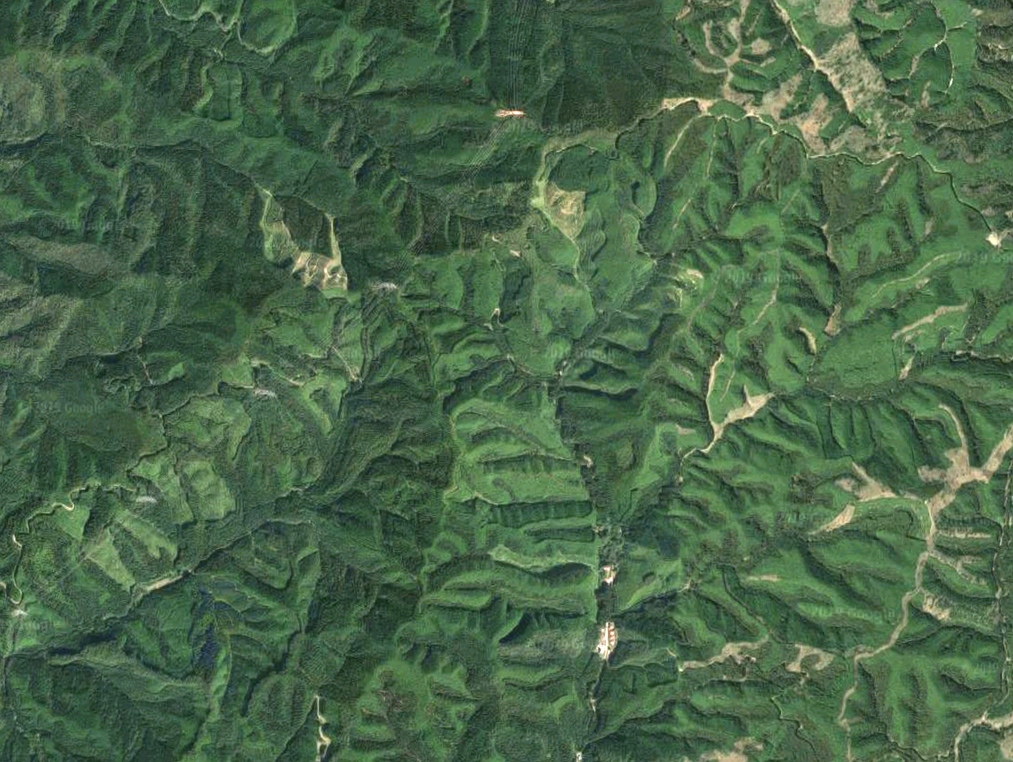
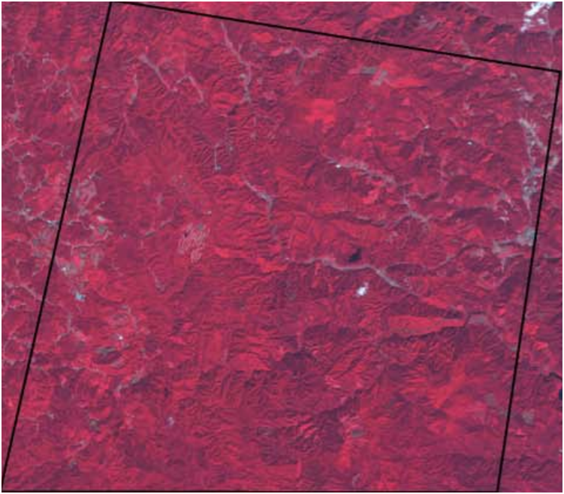
SOURCE
Aerial image of forests in Ibaraki Prefecture, Japan
Spectral composite image of the study area
http://www.cr.chiba-u.jp/~tateishi-lab/pdf/2011/Using%20geographically%202011.pdf
Notes:
2011

Slide 5
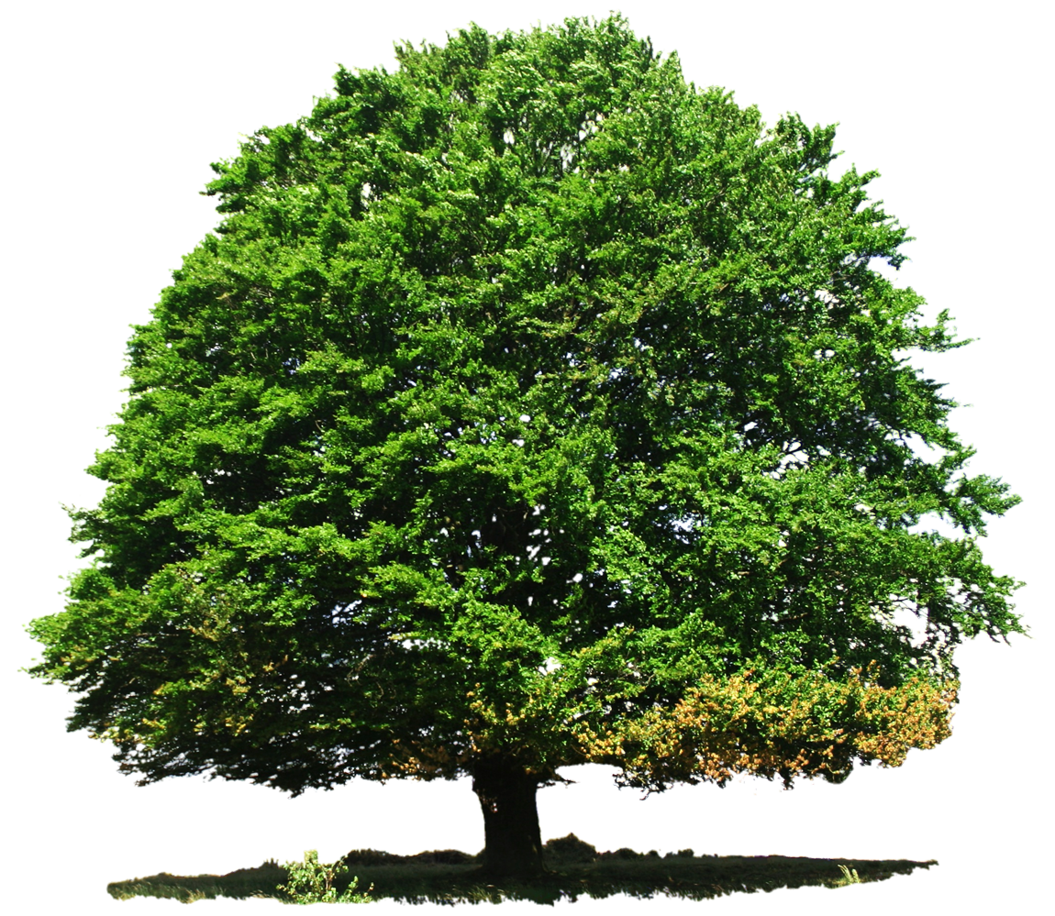
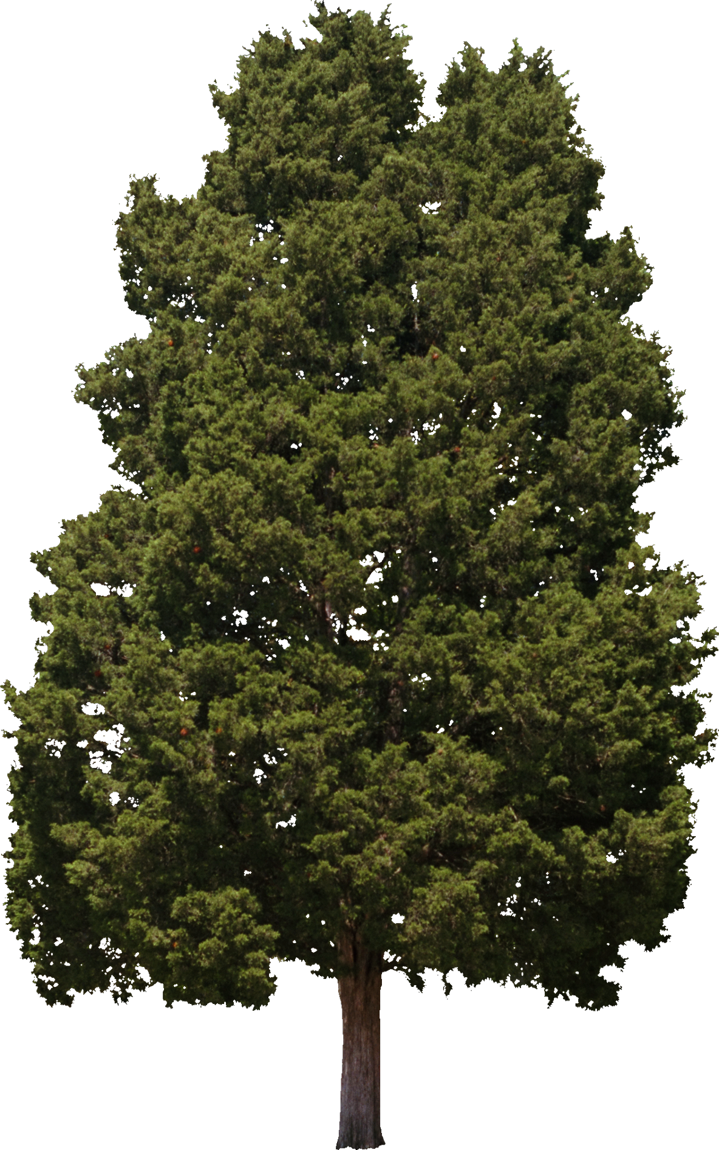


CLASSES
Sugi- ‘s’
Hinoki- ‘h’
Deciduous- ‘d’
Other-‘o’

Slide 6
DATA
27 attributes/features
1~9: ASTER image bands of green, red, & NIR from 3 dates
10~18: predicted spectral values − actual spectral values for ‘s’
19~27: predicted spectral values − actual spectral values for ‘h’
Notes:
KEN

Slide 7
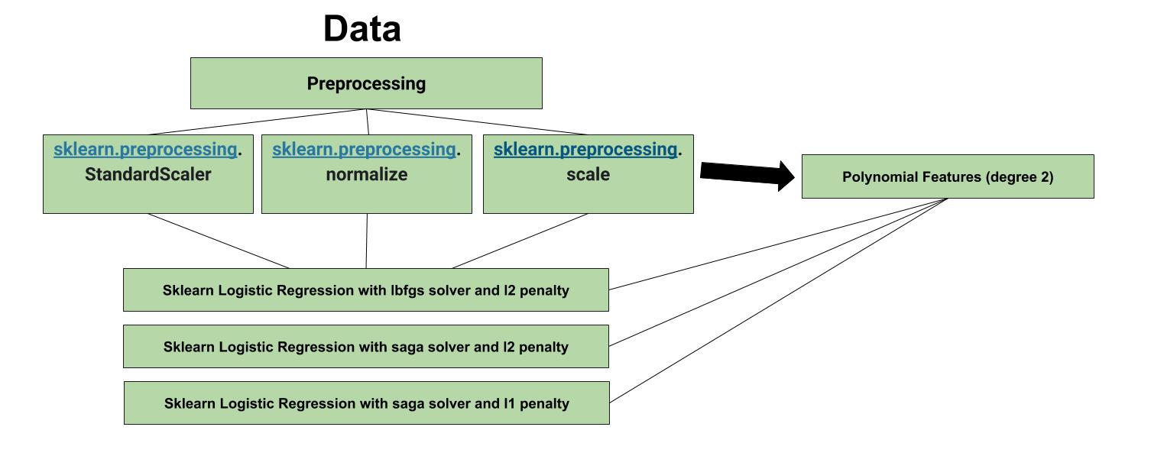
LOGISTIC REGRESSION

Slide 8
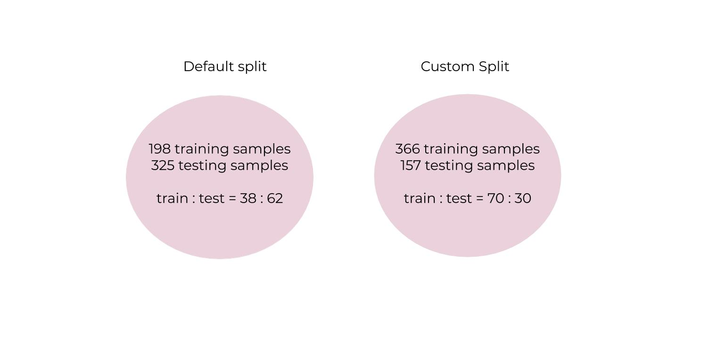
Notes:
When we started working with the default split, we were getting weak results (average accuracy around 70%) for almost all our models.
The best results were obtained for the custom split as it provided with a lot more training data that is needed for both neural networks and regression. So I ran all my models using the custom data split and I obtained some promising results that you will see soon.

Slide 9
sklearn.linear_model.LogisticRegression
Solver | Penalty | Features
lbfgs | l2 | Works better for small sized data
newton-cg | l2 | Works better for small sized data
saga | l1 and l2 | More efficient for large-sized data Only solver that performs l1 regularization for multiclass

Slide 10
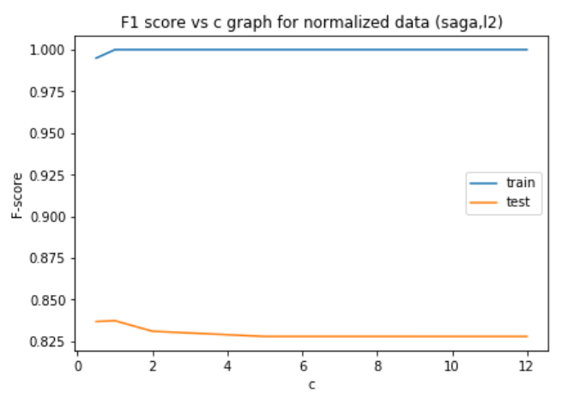
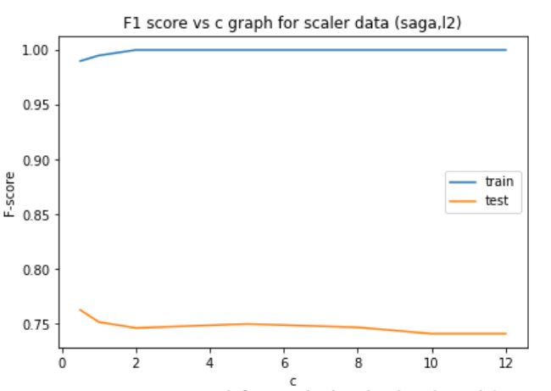
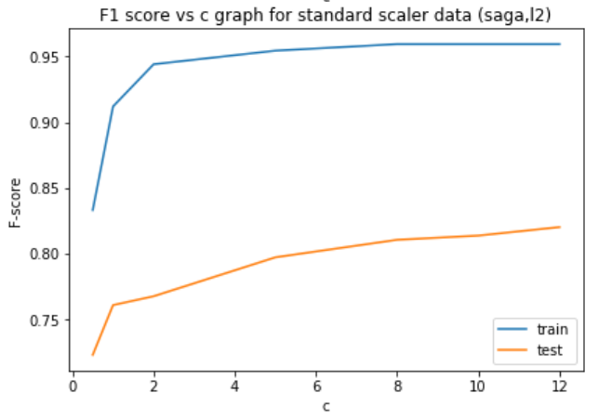
Notes:
F Score vs c graph. Why was F score used to measure accuracy?
Choosing the best ‘c’.

Slide 11
MODEL PERFORMANCE
LOGISTIC REGRESSION
Data Split used | Solver/Penalty | Preprocessing | Max F1 Score (test data) | F1 Score (train data)
Default | saga / l1 | Standard Scalar + Polynomial Features (degree 2) | 0.850283 | 1.0
Custom | saga /l1 | Scale + Polynomial Features (degree 2) | 0.911363 | 0.951253

Slide 12
SVM KERNEL TYPES
Linear
Radial Basis Function(RBF)
Polynomial

Slide 13
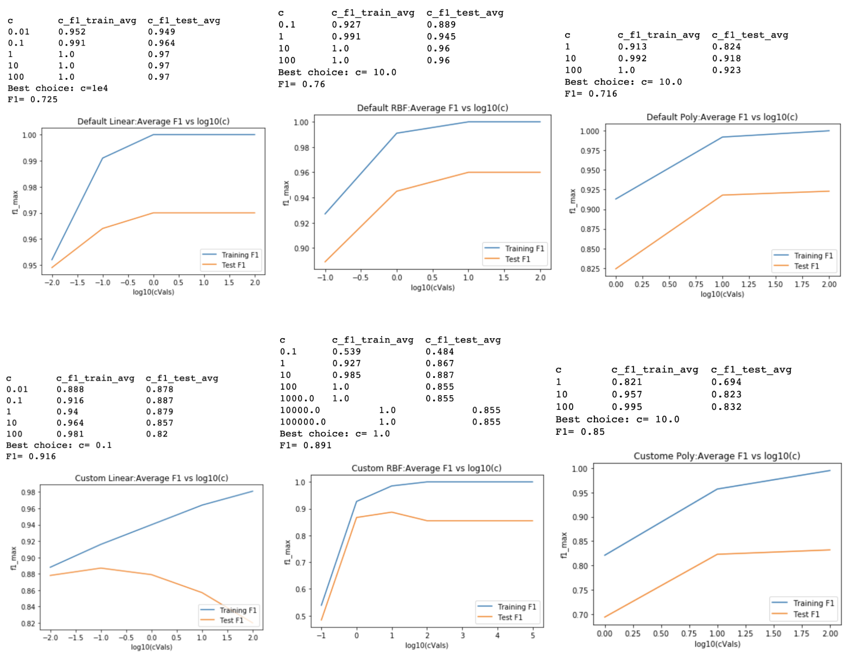

Slide 14
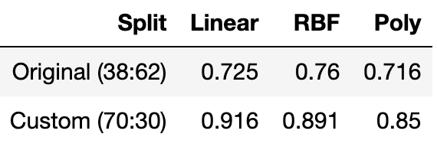
SVM F1 Score Result

Slide 15
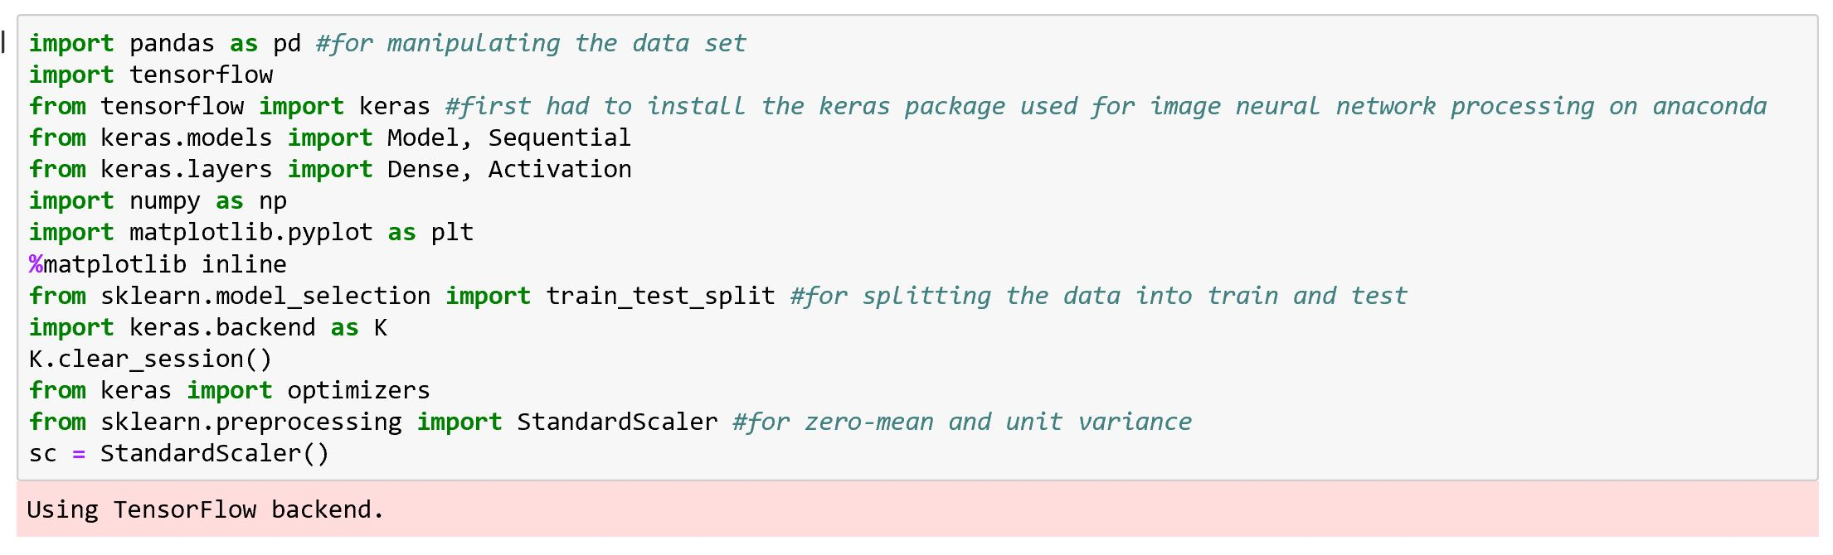
NEURAL NETWORK

Slide 16
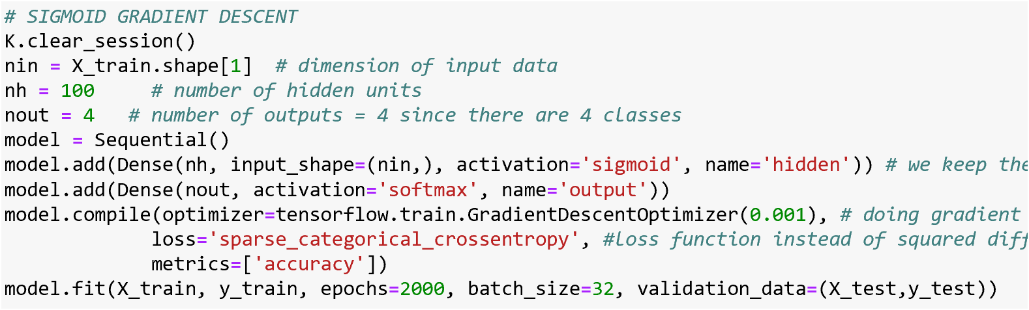

Slide 17
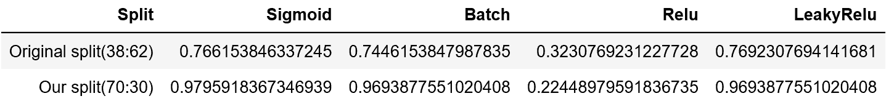
MODEL PERFORMANCE
NEURAL NETWORK
32
16

Slide 18
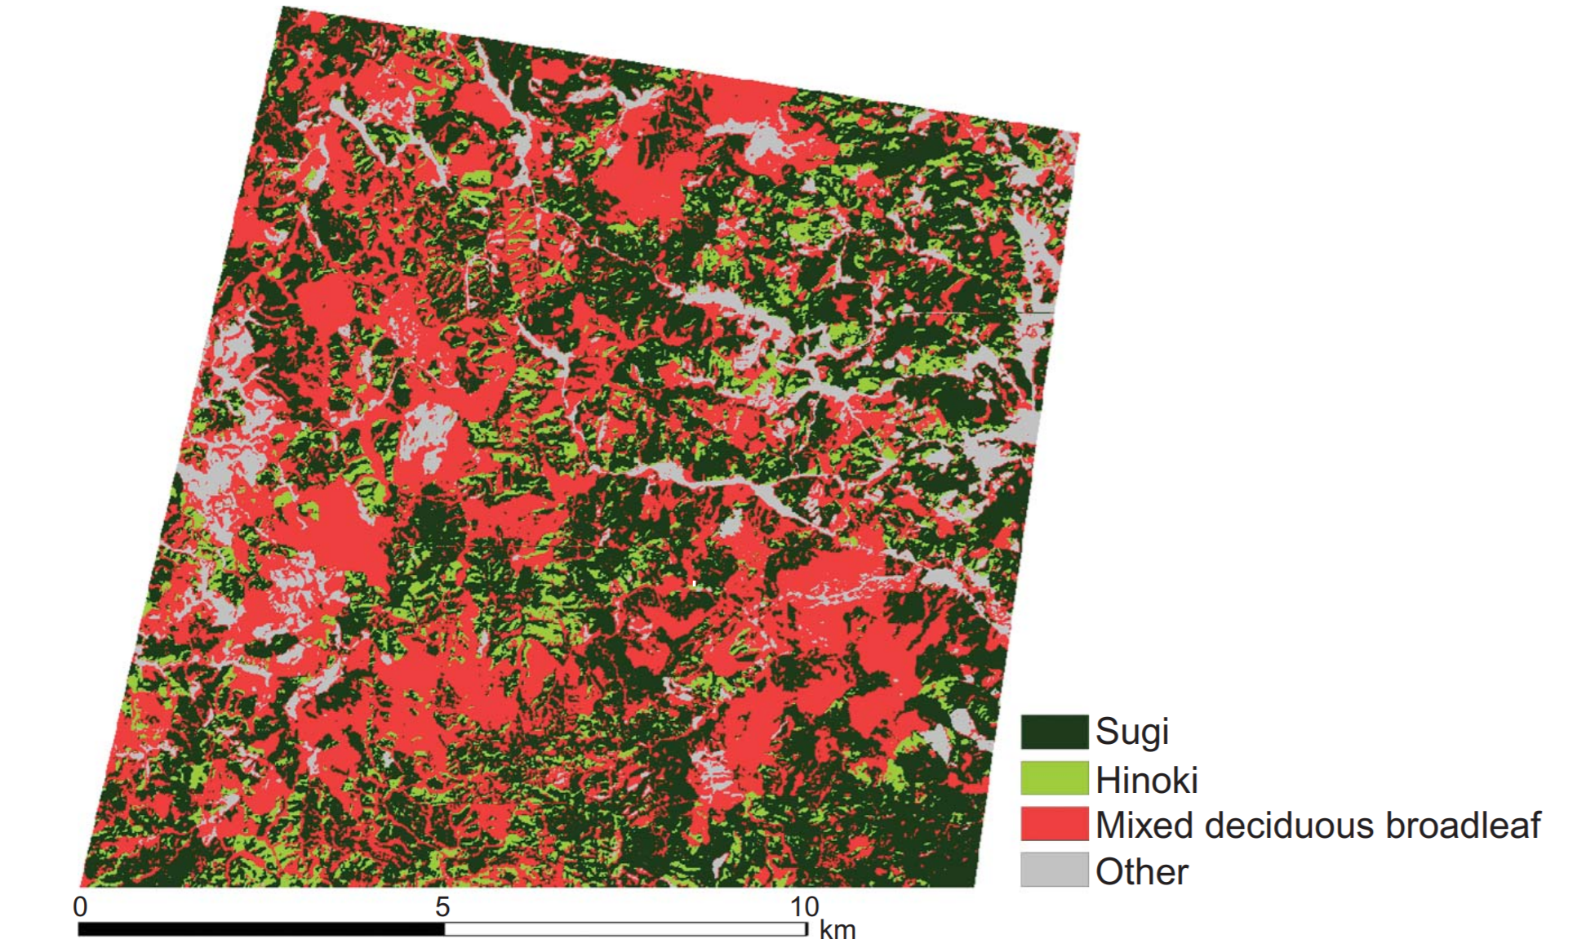
THE RESULT
http://www.cr.chiba-u.jp/~tateishi-lab/pdf/2011/Using%20geographically%202011.pdf

Slide 19
WHAT ABOUT TOMORROW?
Expand target to other terrains (i.e. NYC!)
Incorporate seasonal variations to increase performance.
Get more neural with NN!
Notes:
KEN

Slide 20

THANK YOU
email: mm8625@nyu.edu
ki573@nyu.edu
mt3312@nyu.edu
Acknowledgements: Prof. Linda Sellie
Notes:
Thank you for taking the time to listen to us.

